Slide 1
Individual Behavior and Motivation
MODULE 3

Slide 2
Understanding individual behavior
What is Perception:
Perception in organizational behaviour refers to the process through which individuals interpret and make sense of their environment, including people, events, and situations within the workplace.
It involves selecting, organizing, and interpreting sensory information to form mental representations or perceptions

Slide 3
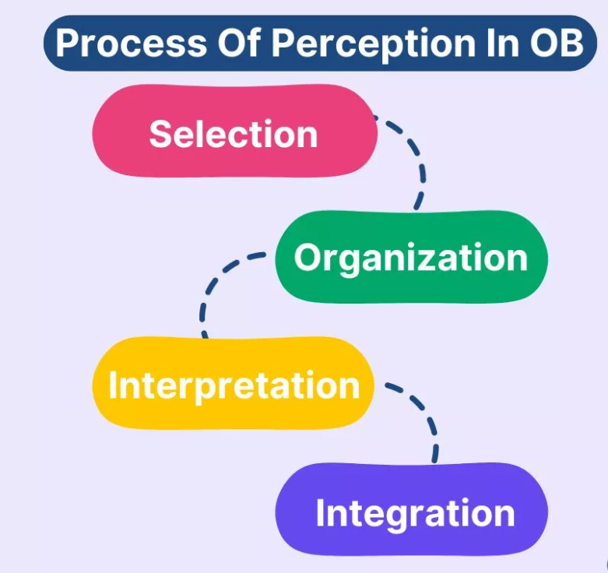
Perceptual Process

Slide 4
Perceptual Process
Selection
Individuals selectively attend to certain stimuli in their environment while ignoring others based on factors such as relevance, salience, and familiarity. In the workplace, employees may prioritize information related to their job responsibilities, goals, and interests.
Organization
Selected stimuli are organized and categorized into meaningful patterns or schemas based on pre-existing knowledge, experiences, and cultural norms.
For example, employees may categorize colleagues as friendly or competitive based on past interactions and social cues.

Slide 5
Perceptual Process
Interpretation
Organized stimuli are interpreted or assigned meaning based on individual perceptions, attributions, and cognitive biases. Interpretations may vary depending on factors such as personality, values, beliefs, and situational context.
For instance, an ambiguous performance review may be perceived as constructive feedback by one employee and as criticism by another.
Integration
Finally, perceptions are integrated into cognitive structures or mental representations that guide behaviour and decision-making. Integrated perceptions influence how individuals respond to challenges, conflicts, and opportunities within the organization, shaping their attitudes, motivations, and interpersonal relationships.

Slide 6
Perceptual Distortion and Types
Perceptual distortion refers to the errors or biases in perceiving and interpreting information about people, situations, or events.
It occurs when individuals misinterpret reality due to personal beliefs, experiences, attitudes, or expectations. In organizations, perceptual distortions can affect decision-making, communication, performance evaluation, and interpersonal relationships.
For example, a manager may assume an employee is lazy because they arrive late once, even though the employee usually performs well.

Slide 7
Types of Perceptual Distortion
1. Stereotyping
Stereotyping occurs when a person judges someone based on the group they belong to rather than their individual qualities.
Example: Assuming that younger employees are irresponsible or that older employees resist technology.
2. Halo Effect
The halo effect happens when one positive trait of a person influences the overall perception of that individual.
Example: If an employee is very polite, a manager may assume the employee is also highly competent even without evidence.

Slide 8
Types of Perceptual Distortion
3. Horn Effect
The horn effect is the opposite of the halo effect, where one negative trait leads to a negative overall impression of a person.
Example: If an employee makes one mistake, the manager may assume that the employee is generally incompetent.
4. Selective Perception
Selective perception occurs when people notice only the information that supports their beliefs and ignore contradictory information.
Example: A manager who believes a particular employee is inefficient may only notice their mistakes and ignore their achievements.

Slide 9
Types of Perceptual Distortion
5. Projection
Projection occurs when individuals attribute their own feelings, motives, or characteristics to others.
Example: A manager who is very competitive may assume that all employees are equally competitive.
6. Attribution Error
This occurs when people incorrectly judge the causes of others’ behavior.
Example: If an employee performs poorly, the manager may assume the employee is careless rather than considering external factors such as workload or lack of resources.
7. Recency Effect
The recency effect occurs when recent events influence a person’s judgment more strongly than earlier events.
Example: During performance appraisal, a manager may evaluate an employee mainly based on their most recent performance.

Slide 10
Attribution
Attribution refers to the process by which individuals interpret and explain the causes of behavior or events. It helps people understand why someone behaved in a particular way.
In organizations, attribution is important because managers often try to determine whether an employee’s behavior or performance is due to personal factors or external situations.
Example: If an employee performs poorly, a manager may try to determine whether the cause is lack of ability (internal) or heavy workload (external).

Slide 11
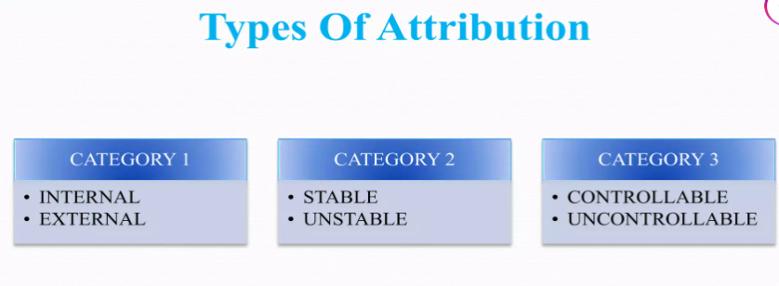
Types of Attribution

Slide 12
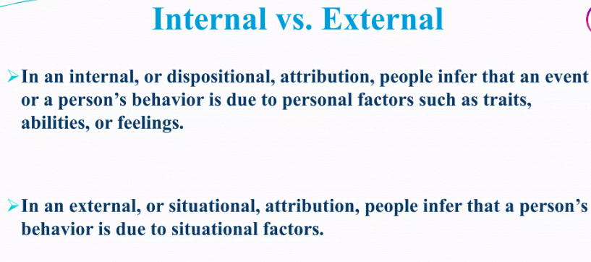
Types of Attribution

Slide 13
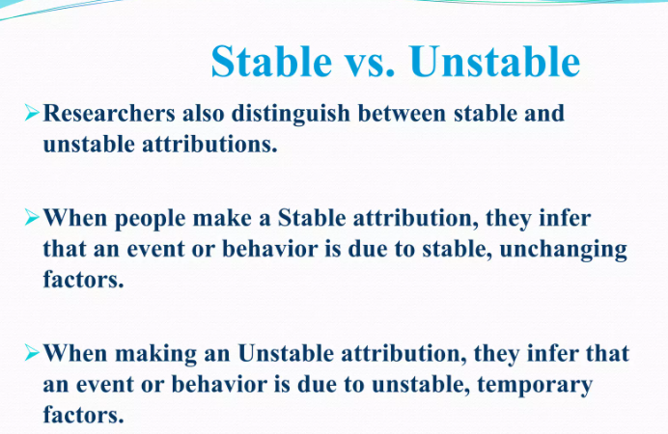
Types of Attribution

Slide 14
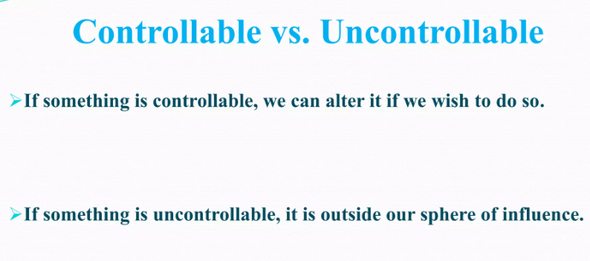
Types of Attribution

Slide 15
Attribution Theory
Attribution theory is a theory about how people explain things.
It seeks to explain how and why people make these causal attributions.

Slide 16
Core Concepts of Attribution Theory
Locus of Control: This concept revolves around whether the cause of an event is perceived to be internal or external.
An internal locus of control means the person believes they can influence events and their outcomes,
while an external locus of control suggests that external forces dictate events.
Stability: Stability refers to whether the cause of an event is seen as stable or unstable over time. Stable causes are seen as permanent (e.g., natural ability), whereas unstable causes are temporary (e.g., mood).
Controllability: This concept deals with whether the cause of an event is something that can be controlled. For instance, effort is a controllable factor, while innate ability is not.

Slide 17
Key Models within Attribution Theory
1) Heider’s Naive Psychology:
Fritz Heider, often considered the father of Attribution Theory.
He proposed that people are intuitive psychologists who try to make sense of the world by attributing causes to behavior.
Kelley’s Covariation Model: Harold Kelley introduced the covariation model, which suggests that people make attributions by considering three types of information: consistency, distinctiveness, and consensus.
Consistency: Does the person behave the same way in similar situations over time?
Distinctiveness: Does the person behave differently in different situations?
Consensus: Do other people behave similarly in the same situation?

Slide 18
Key Models within Attribution Theory
2) Weiner’s Attribution Theory of Motivation and Emotion:
Bernard Weiner expanded Attribution Theory by linking it to motivation and emotion.
He proposed that attributions influence emotions and subsequent behaviors.
For example, attributing failure to a lack of effort (an internal, controllable cause) might lead to feelings of guilt and a motivation to work harder, whereas attributing it to bad luck (an external, uncontrollable cause) might lead to feelings of helplessness and reduced motivation.

Slide 19
Attribution Errors
The Fundamental Attribution Error (FAE), also known as the correspondence bias, refers to the tendency to attribute other people’s behavior to internal factors such as personality traits, abilities, and feelings.
When explaining their own behaviour, on the other hand, people tend to attribute it to situational factors.

Slide 20
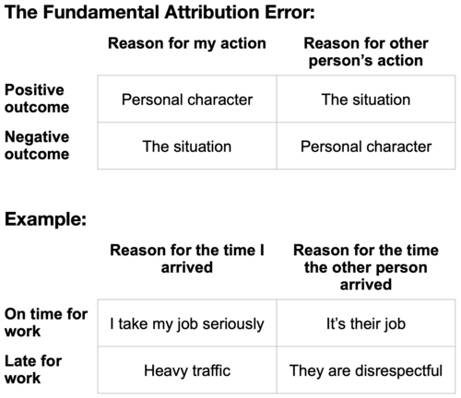
The Fundamental Attribution Error

Slide 21
Actor-Observer Bias
The Actor-Observer Bias is the tendency to attribute our own actions to external factors while attributing others’ actions to internal factors.
Example: If we fail an exam, we might blame the difficulty of the questions or poor teaching (external factors). However, if a peer fails, we might think they didn’t study hard enough (internal factor)

Slide 22
Self-Serving Bias:
The Self-Serving Bias is the tendency to attribute successes to internal factors and failures to external factors to protect our self-esteem .
Example: If we succeed in a project, we might credit our hard work and intelligence (internal attribution). If we fail, we might blame it on a lack of resources or bad luck (external attribution).

Slide 23
Just-World Hypothesis
The Just-World Hypothesis is the belief that the world is fair and people get what they deserve. This bias leads to victim-blaming, where individuals attribute others’ misfortunes to their actions or characteristics .\
Example: Assuming that a person who is mugged was careless or a victim of poverty didn’t work hard enough.

Slide 24
False Consensus Effect
The False Consensus Effect is the tendency to overestimate the extent to which others share our beliefs, attitudes, and behaviors .
Example: Believing that most people agree with our political views or that our preferences are common.

Slide 25
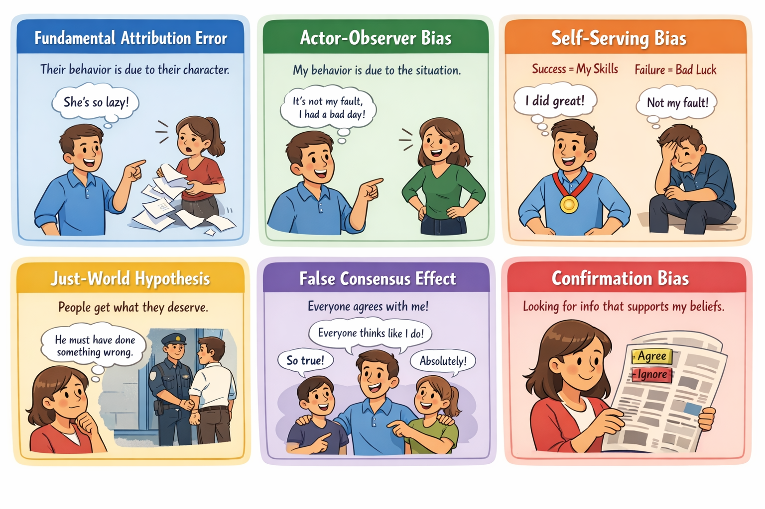

Slide 26
Attitudes
Attitudes can be complex because different people can feel differently about the same things.
For example, while some people may like a certain job, others may not like it at all.

Slide 27
Characteristics of Attitude
Evaluative: Attitudes involve an individual’s positive or negative evaluation of an object, person, group, idea, or event.
Learned: Attitudes are learned through a variety of processes, including direct experience, socialization, and exposure to persuasive messages.
Enduring: Attitudes tend to be enduring, meaning they can persist over time and be resistant to change.
Influence behavior: Attitudes can influence an individual’s behavior, thoughts, and emotions, and can shape their social interactions and relationships.

Slide 28
Characteristics of Attitude
Vary in intensity: Attitudes can vary in intensity, meaning some attitudes may be stronger than others and have a greater influence on behavior.
Multi-dimensional: Attitudes are multi-dimensional, composed of cognitive, affective, and behavioral components.
Context-dependent: Attitudes can be context-dependent, meaning they may change depending on the situation or social context.
Can change over time: While attitudes tend to be enduring, they can change over time through processes such as persuasion, cognitive dissonance, and social influence.

Slide 29
Components of Attitudes (ABC model of attitudes)
1) Cognitive Component
This component reflects the opinion, belief or feeling about something, like the object, people, or event.
Opinion is the expression that a person forms of the facts known to him.
For example, “It is wrong to tell lies” is a belief.
“It is wrong to tell lies, but in that situation, it was necessary to lie, and it didn’t harm anyone, so it’s okay to hide the truth,” is an opinion that justifies a specific situation.

Slide 30
Components of Attitudes (ABC model of attitudes)
2) Affective Component
While cognitive component expresses the opinion or belief about an object or situation, the affective component expresses the feeling or sentiment about that object or situation.
For example,
(i) I like my boss (positive feeling towards boss) or I do not like my boss (negative feeling towards boss).

Slide 31
Components of Attitudes (ABC model of attitudes)
3) Behavioural Component
Cognitive element is the ‘belief’, affective component is how one ‘feels’ about that belief and behavioural component describes how one intends to behave towards the object or situation as influenced by the cognitive and affective components (the belief and the feelings).

Slide 32
Components of Attitudes (ABC model of attitudes)
Attitude of X can be broken into three parts:
Cognitive component – X thinks that promotions should be based on merit, but Y got it. X believes this is unfair.
Affective component – X does not like the work environment at the company because he feels it is not right to use favouritism for promotions. X thinks it is unethical.
Behavioural component – X decides he cannot work in this environment, so he looks for a new job that treats employees fairly.

Slide 33
Attitudes and Consistency
Attitudes and Consistency is an important concept in Organizational Behavior and Social Psychology. It explains how people try to keep their beliefs, attitudes, and behaviors aligned with each other.
An attitude is a person's positive or negative evaluation, feeling, or tendency toward an object, person, or situation.
Example:
A student believes studying regularly is important → Positive attitude toward studying.
Consistency means that people prefer harmony between their attitudes and their actions.
When there is inconsistency, individuals feel psychological discomfort and try to correct it.
Example:
If someone believes smoking is harmful but still smokes, they feel uncomfortable and may:
Quit smoking, or
Justify it by saying “I only smoke occasionally.”

Slide 34
Cognitive dissonance theory
The concept of attitude consistency is strongly explained by Cognitive Dissonance Theory, developed by Leon Festinger.
Cognitive dissonance theory was first presented by Leon Festinger in 1957 in order to explain the relationships between the motivation, perceptions and cognitions of an individual.
Festinger (Festinger, 1962) defined the ‘cognition’ as any piece of knowledge that an individual has about themself or their environment.
The theory was based on the belief that people strive toward consistency within themselves and are driven to make changes to reduce or eliminate an inconsistency

Slide 35
Cognitive dissonance theory
Cognitive dissonance theory began by postulating that pairs of cognitions can be either relevant or irrelevant to one another.
If two cognitions are relevant and concurring, there is consonance.
However, if two cognitions are relevant, but conflicting, the existence of dissonance would cause psychological discomfort and motivate the individual to act upon this.

Slide 36
Cognitive dissonance theory
Four ways to reduce a dissonance
1) an individual can reduce the mental discomfort by changing the inconsistent cognition
2) reducing the importance of conflicting elements
3) acquiring new harmonious elements or
4) increasing the importance of the existing consistent elements.

Slide 37
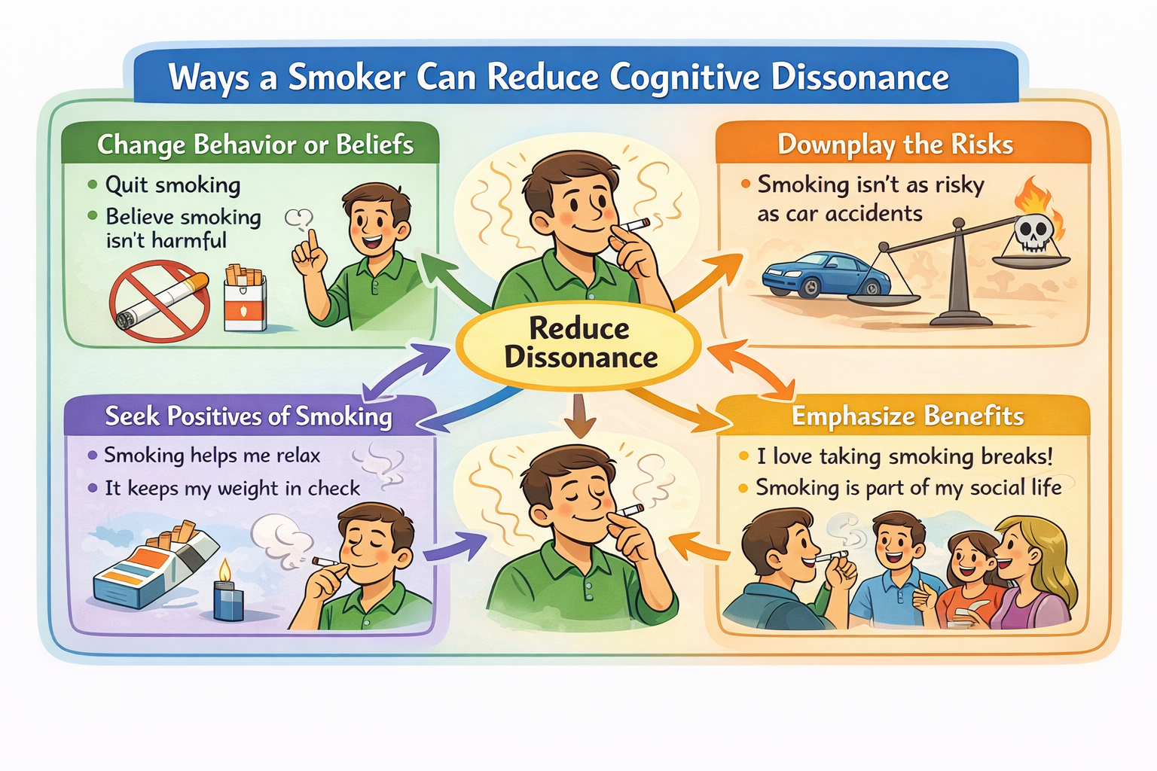
Example
Four ways that the smoker can reduce the dissonance.

